Slide 1

Concord Carlisle High School Oct 4, 2017
7 BILLION PEOPLE
200 COUNTRIES
ALL PRODUCING DATA
An Introduction to Engineering Computation
& Data Science
John R Williams, jrw@mit.edu and Abel Sanchez, abel@mit.edu
Massachusetts Institute of Technology

Slide 2
Overview
Web Computing – what it is and why its important
How the Web works?
Writing our first Web Server
Node.js and Open Source
JavaScript – Objects, Functions and Arrays
JSON – Walking through data
Mini Project – Boston City Data

Slide 3

Rise of Systems & Data

Slide 4
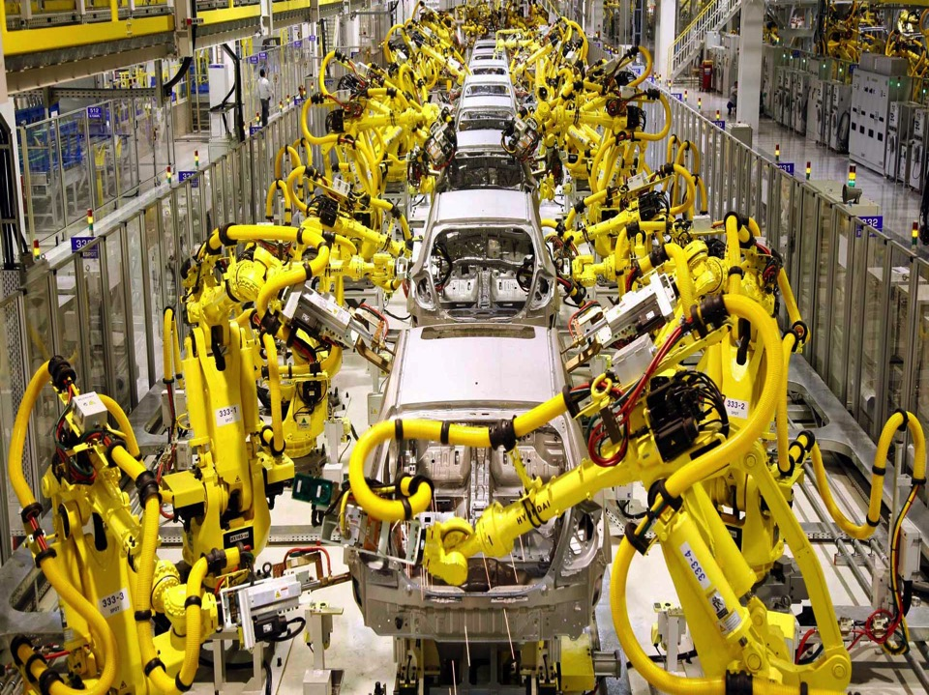
More Systems & More Data

Slide 5




Everywhere

Slide 6

Abstractions for Building
Software Systems Have Risen

Slide 7

New normal: A Single Person can
Build a Complex Software System

Slide 8

New normal: A Small Team can
Challenge an Industry

Slide 9
A New Challenge
for All

Slide 10

Challenge: develop the ability to conceptualize and represent problems in a way that a computer can solve.

Slide 11

The ability to formulate a problem in a way that a computer can solve it is fundamental to the modern practice of engineering.

Slide 12

Posing your idea in terms of computation is much more than being able to program a computer. It requires thinking in terms of systems.

Slide 13


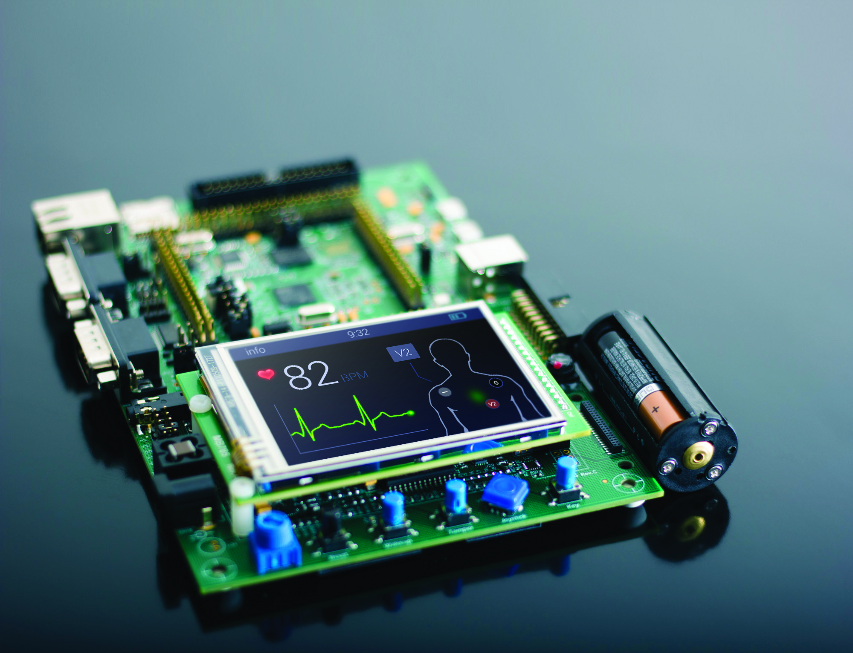

Blockchain
Data
Science
IOT
Machine
Learning
NEW PILLARS

Slide 14



Voice
X Reality
Security
NEW PILLARS

